Slide 1
Newton’s Law of Gravitation
Force of gravitation
Law of force of gravitation
Newton’s law of gravitation

Slide 2
Force of Gravitation
Definition:
The force of attraction between all masses in the universe; especially the attraction of the earth's mass for bodies near its surface.
The force of attraction that bodies exert on one another as a result of their mass. any process or result caused by this interaction.

Slide 3
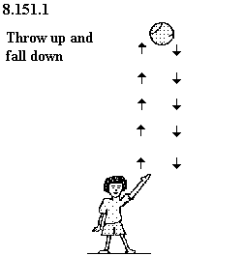
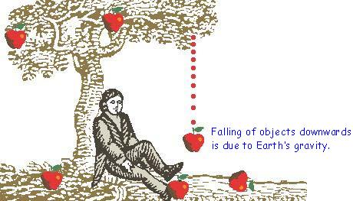
Example:
The force that holds the gases in the sun.
The force that causes a ball you throw in the air to come down again.
The force that causes a car to coast down hill even when you aren't stepping on the gas.

Slide 4
Law of Force of Gravitation
Definition:
Everybody in the universe attracts every other body with a force which is directly proportional to the product of their masses and inversely proportional to the square of distance between their centres.

Slide 5
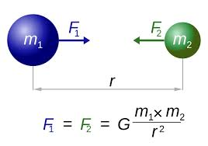
Explanation:
Consider two bodies of masses m₁ and m₂ . The distance between the centres of the masses is d.

Slide 6
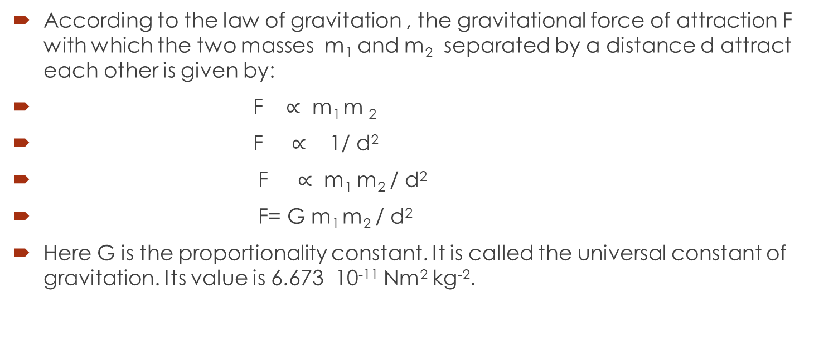
Cont…
According to the law of gravitation , the gravitational force of attraction F with which the two masses m₁ and m₂ separated by a distance d attract each other is given by:
F $∝$ m₁ m ₂
F $∝$ 1/ d²
F $∝$ m₁ m₂ / d²
F= G m₁ m₂ / d²
Here G is the proportionality constant. It is called the universal constant of gravitation. Its value is 6.673 10⁻¹¹ Nm² kg⁻².

Slide 7
Cont…
Due to the small value of G, the gravitational force of attraction between objects around us is very small and we do not feel it.
Since the mass of earth is very large, it attracts nearby object with a significance force.
The weights of an object on the earth is the result of gravitational force of attraction between the earth and the object.

Slide 8
Law of Gravitation and Newton’s Third Law of Motion
It is to be noted that mass m₁ attracts m₂ towards it with a force F while mass m₂ attracts m₁ toward it with a force of the same magnitude F but in opposite direction.
If the force acting on m₁ is considered as action than the force acting on m₂ will be reaction. The action and reaction due to force of gravitation.
This is consistent with Newton’s Third Law of Motion which states, Two every action there is always an equal but opposite reaction.

Slide 9
Problem:
Two lead spheres each of mass 1000kg are kept with their centres 1m apart. Find the gravitational force with which they attract each other.
Given data:
m₁ = 1000kg
m₂ = 1000kg
d = 1m
Required:
F=?

Slide 10
Cont…
Solution:
We know that:
F = G m₁ m₂ / d²
By putting the value:
F = 6.673 × 10⁻¹¹Nm² kg⁻² × 1000kg × 1000 kg / (1m)²
F = 6.673 × 10⁻⁵ N

